Slide 1
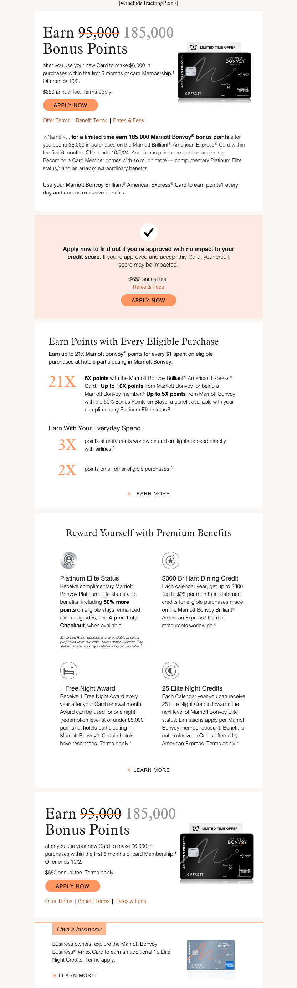
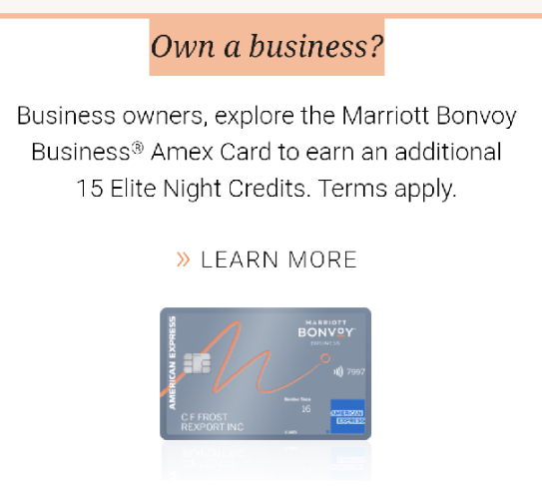
https://marketofocused.netlify.app/marriott/3470-brilliant-bevy/briliant/index.html
Is it possible to use a diagonal strikethrough like the Figma file? Or will that be too difficult to code?
Bold “185,000”
Add in animated gif here from Images folder
Reminder: add the static image as a fallback in the code for when the gif doesn’t load
Remove extra comma
Add “Bonvoy” in between “Marriott” and “Brilliant®”
Change “1” to “3” and superscript it
Reduce size of this subhead to 15pt to match the size of “Earn up to 21X…” above
Update icon with new version from Images folder
We added a white fill to the icons because in dark mode these are disappearing
Update icon with new version from Images folder
We added a white fill to the icons because in dark mode these are disappearing
Remove “Terms apply.” but keep the superscript 7 at the end
Bold “185,000”
Can you add more padding on the left and right side of the text for mobile? In mobile the text is too close to the edges
Update with new version from Images folder that has opacity gradient for reflection

